Slide 1
Big Mountain Resort Ticket Pricing

Slide 2
The Problem
The current price of tickets for the resort are 81$. There’s discussion that our pricing model might be wrong and that we could be losing profits.
On top of this, the resort has added a brand new chair lift which will increase expenditure costs by 1.5 million dollars.
How can we optimize the price of adult tickets so that at the very least, we can offset the expenditure costs that come with the new chair lift?
What features are valued by customers?

Slide 3
Findings
The most predictive model had an error of $~9 and predicted that the price of the tickets should be set at $95.87. This means that AT THE VERY LEAST the price of the tickets should be increased from $81 to $86.

Slide 4
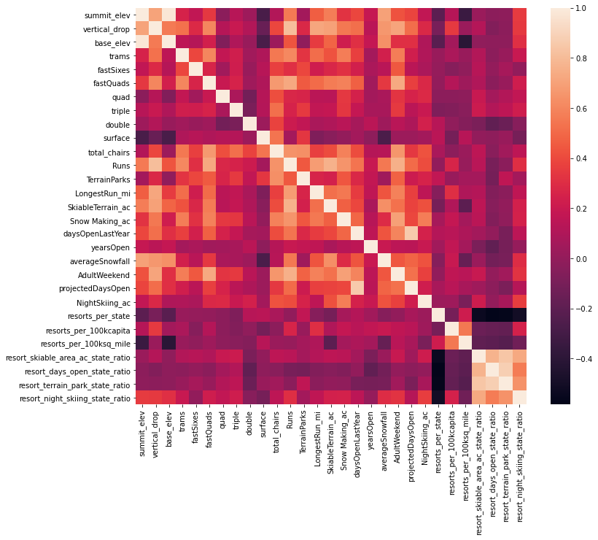
Heatmap
-This map shows us what features influence each other the most. For ticket price, the map shows that runs, fastQuads, vertical drop, snow making, longest runs, total chairs, and skiable terrain

Slide 5
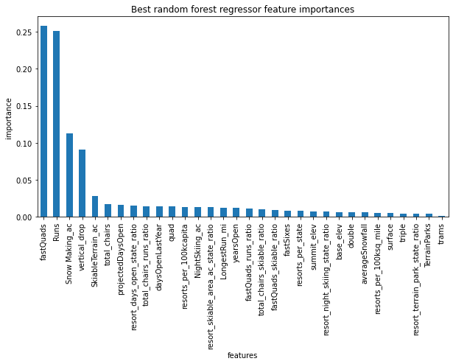
Forest Regression Model
-When creating our model based on the mean of ticket prices of all resorts, we were able to find that our model reflects what the heatmap showed were important features for ticket price.

Slide 6
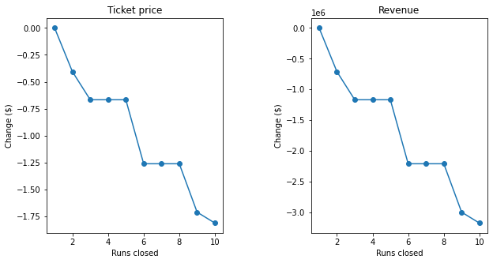
A focus on Runs
-Closing 1-3 runs will have a significant impact on both revenue and ticket price according to our model. But if Big Mountain is forced to close 3 runs, they might as well close 5 runs because there is no difference in ticket price or revenue.

Slide 7
Modeling Results
Our modeling results suggest that we can Increase the ticket price from $81 to $95.87.
When creating scenarios for increase in snow making and longest run, we found that they would not affect the predicted price from the model.
Adding a chair lift, will cause our model to increase ticket price by $2.

Slide 8
Conclusion
Big Mountain Resort cannot afford to base their price off of their local competitors. Otherwise, the company will be losing out on money.
The resort must increase the price of their ticket. At the very least, it needs to be increased from $81 to $86, though it is reasonable to increase it to $95.87.

